Slide 1
Exploring Shooting Incidents in New York City
DTSC 5301 Sociology Group
Karan Juneja, Andrew Edds, Darsh Shah, Vishwam Thakkar, & Rajas Umalkarm
September 23rd, 2021

Slide 2
Background

Slide 3
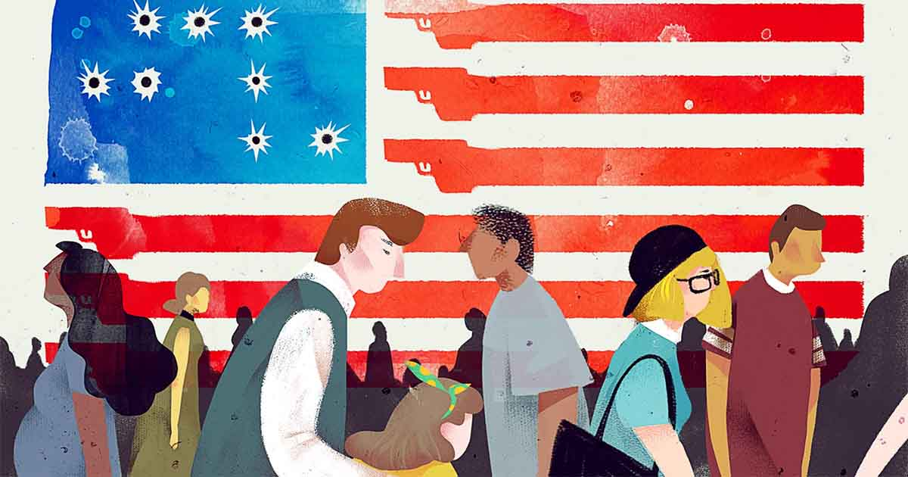
Introduction
Gun violence in America is rampant; time for reform is now
American society + politics are divisive
Many questions about how to improve gun safety, and data is the tool to answer them
Notes:
With the most guns per capita by several factors and increasing calls for gun policy reform, the United States’ gun violence issue is significant and worth analyzing. Especially today
Divisive times - socially, electorally, with crime, racism, poverty, everything etc.
Specifically gun violence, Americans are very split

Slide 4
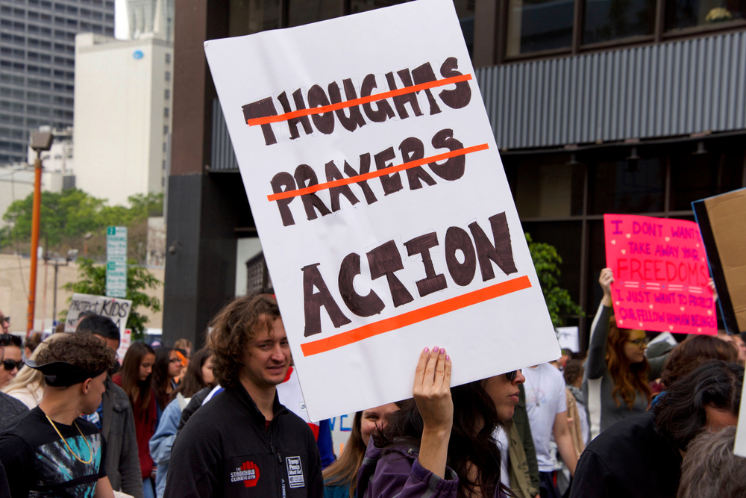
Shootings in NYC
City centers: not just hotspots of crime, but data too
Prevalence of shootings in NYC
With such concentrations of crime, investigating incidents in NYC is relevant Many questions can be asked regarding shooting dynamics, patterns, and changes over time
Notes:
Especially in city centers, data analysis shooting incidents is important. Not only more crime, ut data is better
NYC, biggest metro, has crime and data. But also interesting due to shifting patterns.
Figuring out how these patterns change is very interesting
Politial climates, social environments etc.
So many questions about why things are this way, and by using data science, we can anser some of these questions about how crime changes across time

Slide 5

Shootings During 2020
2020 was a crazy year!
Understanding crime patterns in these unprecedented times is of high interest
Nationwide vs. Global challenges
Intuition vs. reality
Notes:
2020, crazy year! Not only pandemic (lockdown, jobs, death, sickness, stimulus), but social unrest and political election --
Brought up a lot of questions + expectations about how crime would change this year, nationwide and globally
This intrigued the research team, as we began to have intuition about how crime would alter.
But without completing a proper data analysis, it would be hard to know. We were invested in knowing in which ways crime has altered, which lead to the formation of our question of interest:

Slide 6
Research Team Question of Interest
Did 2020 shooting patterns in New York City differ dramatically from prior years?

Slide 7
Dataset and Methods
Data acquired from the NYPD Dataset called “NYPD Shooting Incident Data (Historic)”.
Variables of Interest:
BORO
Statistical_Murder_Flag
Perp_Age_Group
Vic_Age_Group
Perp_Race, Vic_Race
Notes:
Dataset - how was it obtained? What is it called? How is it structured
Variables of interest - give a couple
Method (steps) - initially explore data, build basic vizs, identify interesting patterns + visualize, model, gather findings, report

Slide 8
Visualizations

Slide 9
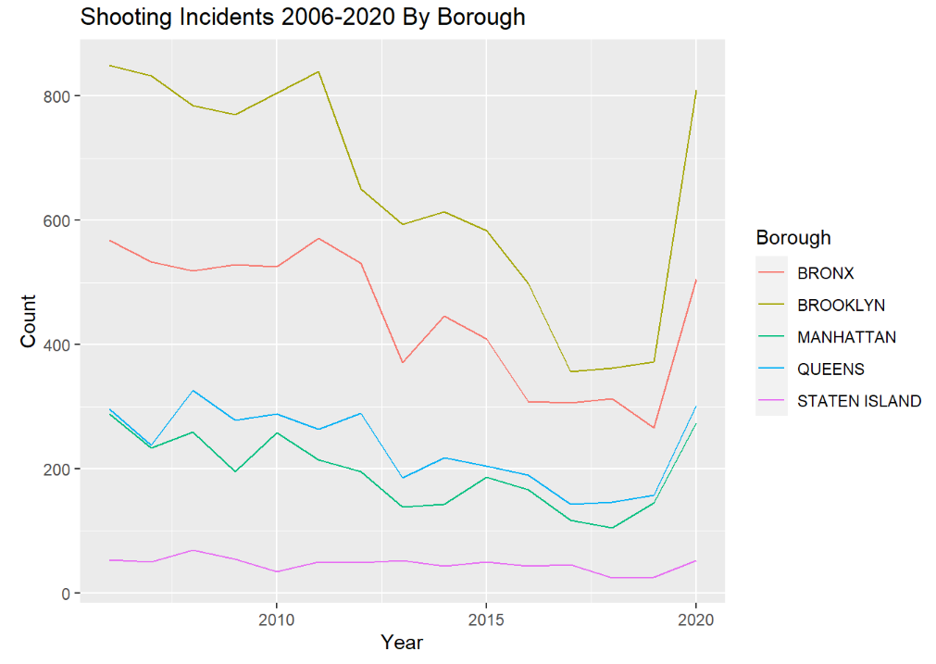
Shootings in NYC across the Years
Overall a decline in Shootings.
Massive spike in 2020.
Increase by 97% from 2019.

Slide 10
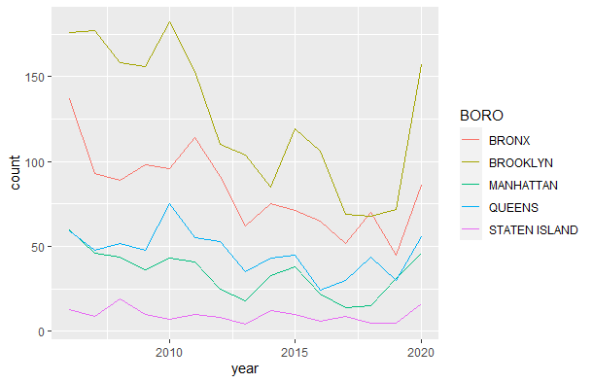
Homicides across Years
Similar trend to # of shootings.
Massive spike in 2020.
Increase by 45% from 2019.

Slide 11
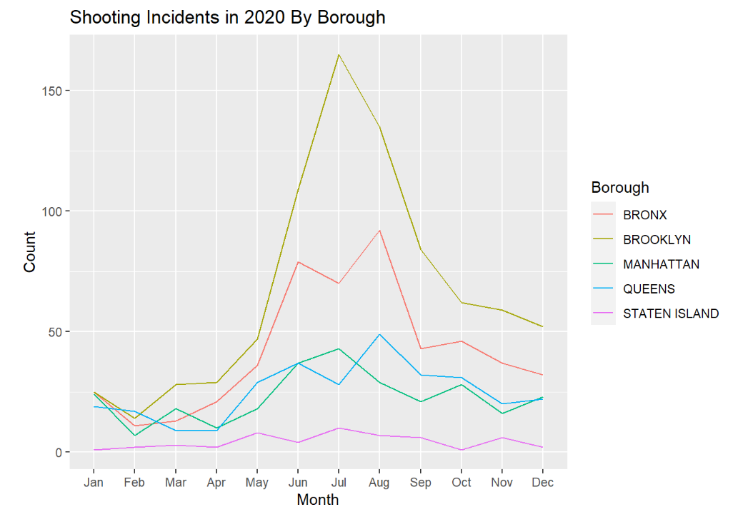
Shooting trends in 2020
March, 2020 - COVID-19 outbreak in NYC
April 6, 2020. - Stay at home orders extended.
May 28, 2020 - George Floyd protests start in NYC
Nov 3, 2020 - Presidential elections

Slide 12
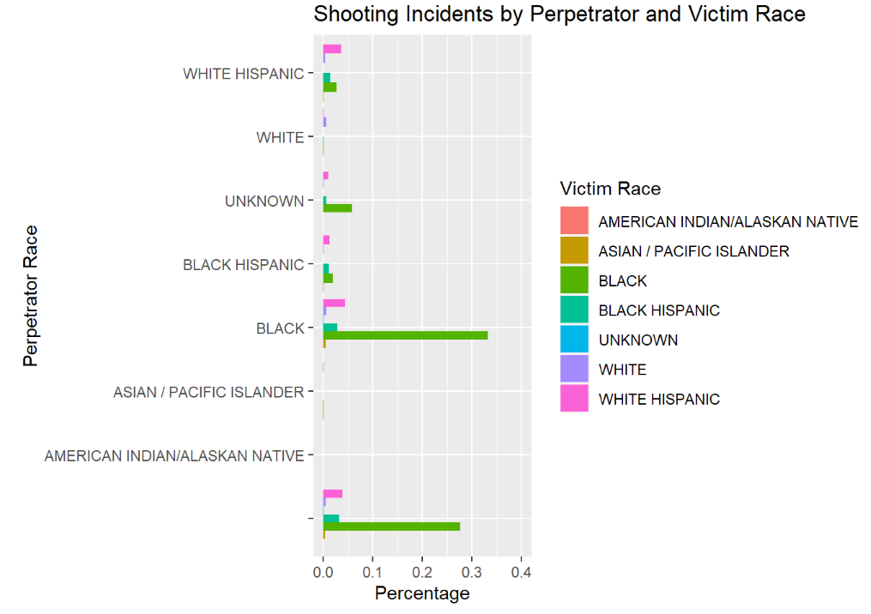
Shooting Incidents by Victim and Perpetrator Race

Slide 13
Interesting Analysis

Slide 14
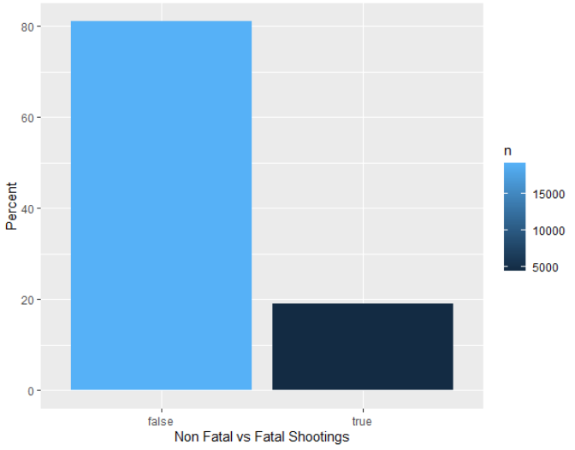
Fatal vs Non-Fatal Shootings
Non Fatal vs Fatal Shootings
Fatal - 19%
Non Fatal - 81%

Slide 15
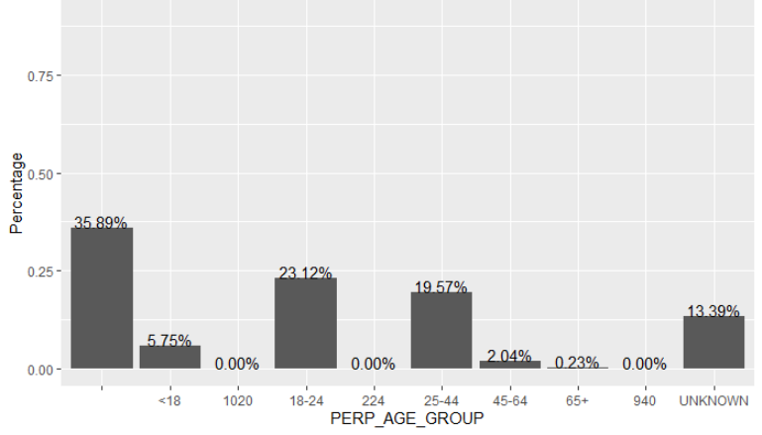
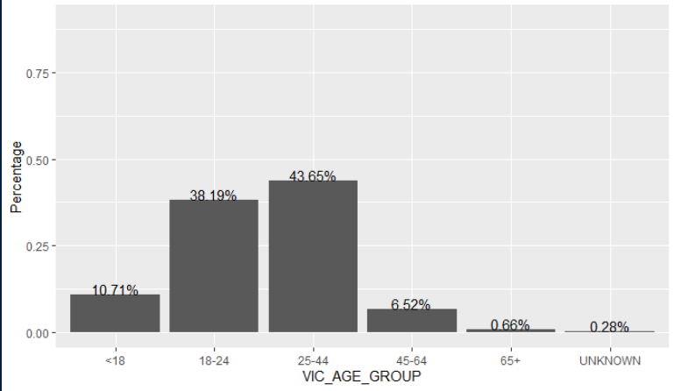
Shooting Incidents by Victim and Perpetrator Age Group

Slide 16
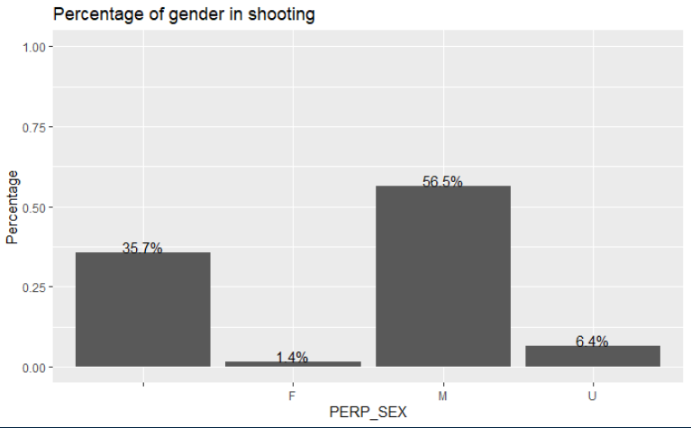
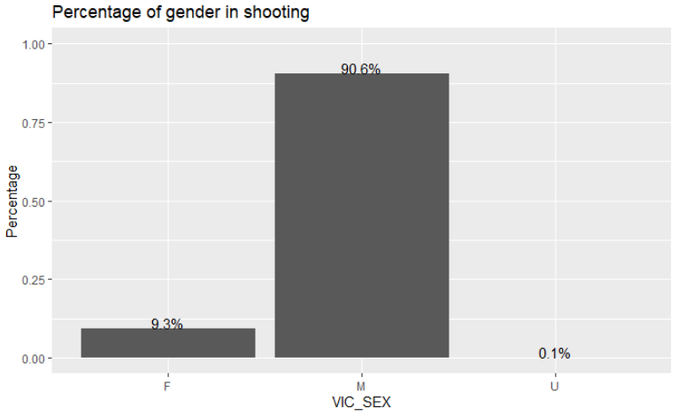
Shooting Incidents by Victim and Perpetrator Gender

Slide 17
Model

Slide 18
Model Construction
Created a variable called shootings per day.
Encoded the variables to integer with dtype as chr.
Target variable is “Shootings” all the other variables were used as predictor.
Used GLM to create a model.

Slide 19
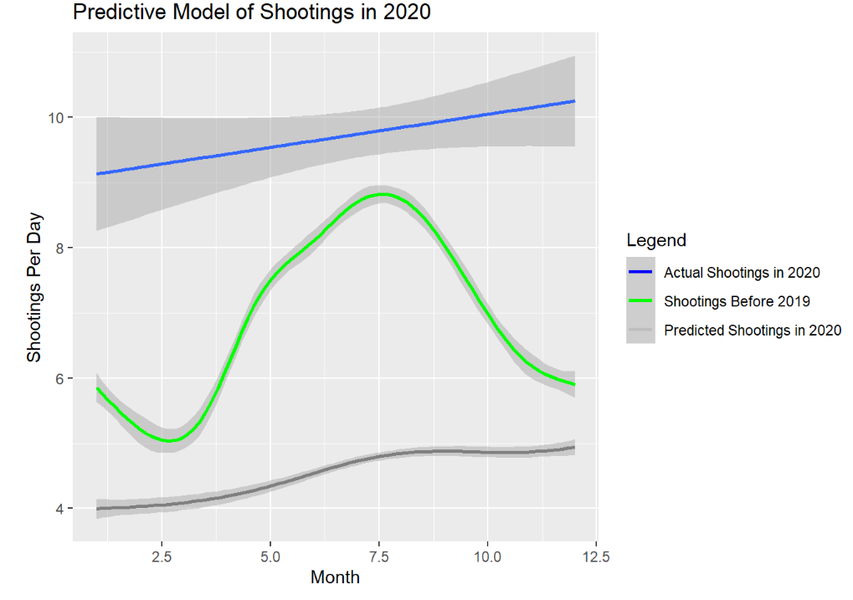
Model Results
Predictions

Slide 20
Model Improvements
Can use ANOVA , FbProphet to forecast.
Decision Trees.
Can change the target variable.
RNN , LSTMs with more data points.

Slide 21
Conclusion

Slide 22
KEY TAKEAWAYS
Majority of shooting incidents were from people of black race.
Most of the shooters were Male.
18-24 age group committed the most shootings.
Brooklyn was the area with the lion’s share of shootings.
2020 was a year of major crime with more than 2000 shootings incidents.
2017-2019 on an average had 900 shootings incidents / year.
We answered our question of interest: 2020 shooting patterns in New York City differed dramatically from prior years.
Notes:
Did we answer our hypothesis? **

Slide 23
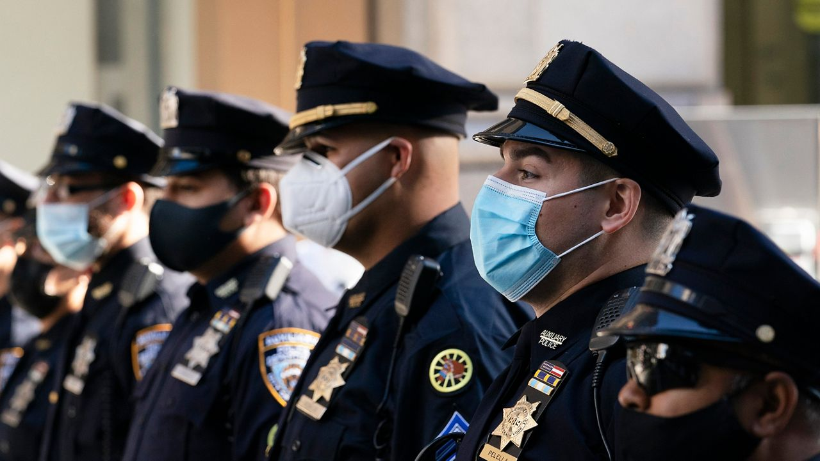
Acknowledging Biases in the Dataset and Analysis
Personal bias
Racism in Policing
Dataset biases
Data collection: Which shootings are counted?
Data construction: Observations are by shooting incident, not by person.
Notes:
Coming into this study, the research team acknowledged a personal bias regarding racism in policing in the United States. Police departments across the country have been criticized of racial discrepancies in the prosecution of people of color, leading to disparities in the allocation of resources and intentions of officers. There are many different ways that this bias has been constructed, but overall the research team had an expectation that the dataset would be biased in the racial demographics of perpetrators and victims of shootings in NYC. Given this bias, which the research group identified using visualizations, the research group focused on the time-series analysis of this data rather than the demographic data of potential perpetrators.
In addition to the personal bias acknowledged above, there were several aspects of the dataset’s collection, construction, and presentation that must be recognized as potential dataset bias. Firstly, this dataset has been constructed to have each observation represent a different shooting incident, not a criminal, meaning that perpetrators can be recorded multiple times. Thus, analyses regarding the demographics of perpetrators and victims are skewed, and models that predict shooting incidents rather than criminal background. Another bias that might exist in the dataset is the lack of information regarding which shootings are recorded. The research group is curious about the potential recording of accidental shootings, shootings where the perpetrator is a police officer, and shootings where the perpetrator is lawfully self protecting or defending another person. It is difficult to prove the influence of these acknowledged potential biases, however, in future studies, results would be improved if these biases could be accounted for and properly understood.

Slide 24
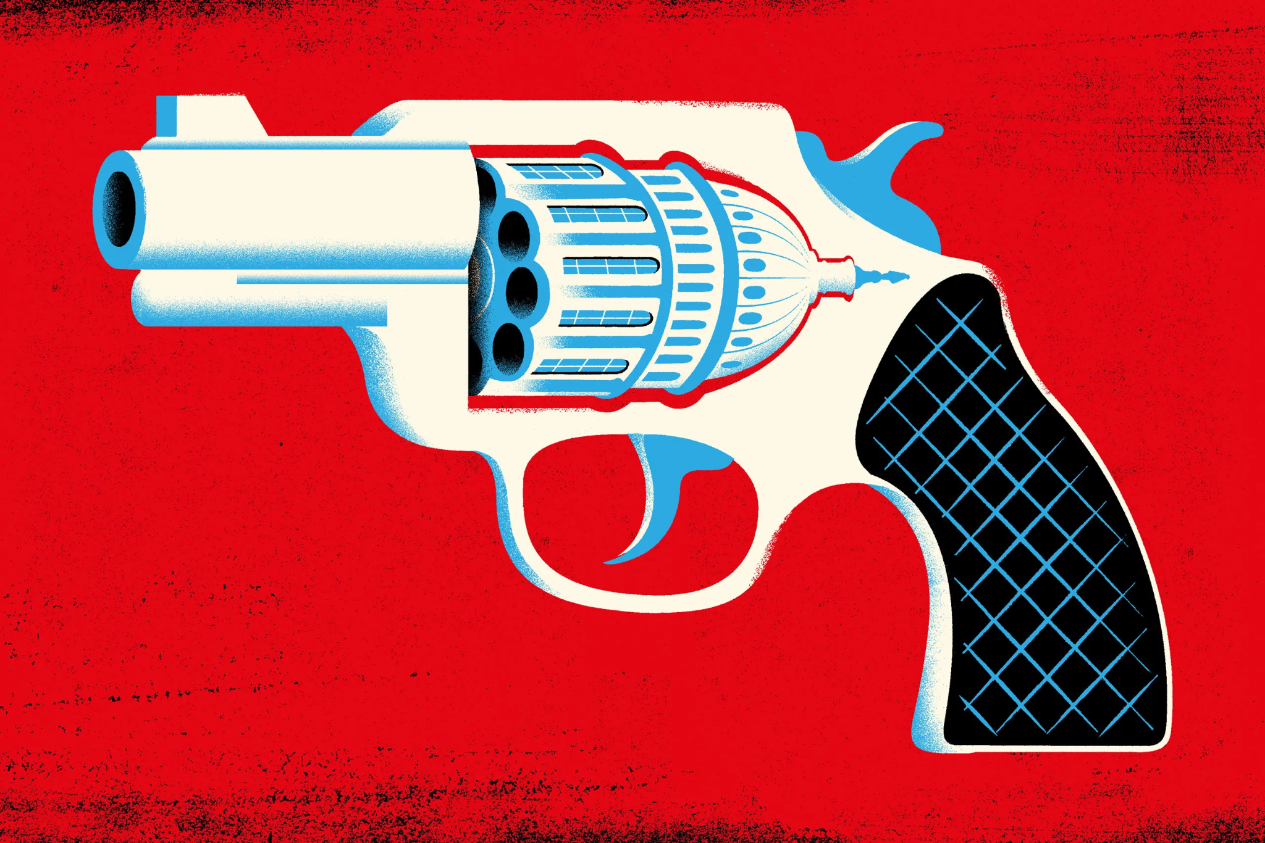
Next Steps & Future Research
Limitations of this research
Possible future analyses
Policy recommendations
Notes:
How could this be improved?
What policy recommendations could be made?
In future pandemics, what should we do to monitor crime patterns?

Slide 25
Questions?

